Slide 1
Database Connectivity - DAO
Module 2: 07

Slide 2
Objectives
JDBC
SpringJDBC
Making Connections
Executing SQL Statements
Parameterized Queries
Getting Results
Working with Sequences
DAO (Data Access Object) Pattern

Slide 3
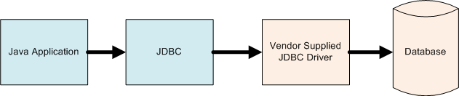
JDBC
Java Database Connectivity (JDBC) is a library that allows Java applications to access SQL databases in a standard way. The vendor of the database provides a Driver that implements an interface that JDBC is expecting. Java Applications then use the JDBC library and JDBC calls the vendor supplied driver to access the specified database. This allows Java Applications to be written in a generic fashion without regard to what SQL database they are using.

Slide 4
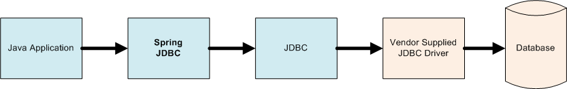
Spring JDBC
SpringJDBC is a framework that provides an abstraction for JDBC making it easier to use.
SpringJDBC provides a consistent way to create queries, handle results, deal with exception, and automatically provides transactions.
Our Java Applications will use the SpringJDBC Framework, which will utilize JDBC to call the Vendor Supplied JDBC Driver to access the Database.

Slide 5
A Connection Pool works like a library of connections. The Connection Pool makes multiple connections to the database and keeps them open. When an application needs a connection it “checks one out” from the pool. When it is finished with it it returns it to be reused. This reduces the overhead of a new connection each database access is needed. Multiple Applications can use the same Connection Pool, allowing for fewer overall connections.
Application Requests a Connection
Connection
Database
Application
Connection
2. Connection returned from pool
Connection
3. When Connection is closed by Application it is returned to the Pool
Connection
Connection Pool

Slide 6
Making a Connection
A Connection String is like an address (URL) to a web site only used to connect to a database. It includes details on what vendor driver to use, where the database is located on a network, the name of the database to connect to, and the credentials (user id / password).
BasicDataSource dvdstoreDataSource = new BasicDataSource();
dvdstoreDataSource.setUrl("jdbc:postgresql://localhost:5432/dvdstore");
dvdstoreDataSource.setUsername("postgres");
dvdstoreDataSource.setPassword("postgres1");
BasicDataSource - The org.apache.commons.dbcp2.BasicDataSource provides the ability to make a database connection and a Connection Pool.
The setUrl takes a connection string as an argument: jdbc:postgresql://localhost:5432/dvdstore
jdbc:postgresql:// tells the DataSource to use JDBC with the PostgreSQL Vendor Driver
localhost:5432 tells the DataSource the location of the database on a network, in this case the same computer.
dvdstore is the name of the database which to connect
setUsername() and setPassword() methods set the username and password to use when connecting to the database

Slide 7
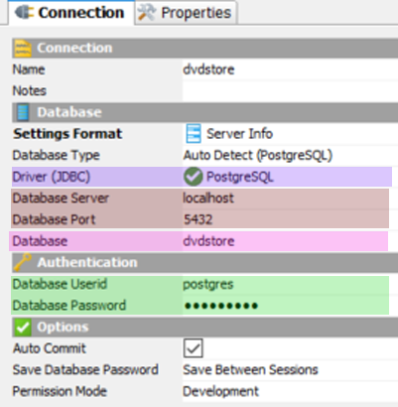
The JDBC Connection String matches what we have been setting in DbVisualizer, which is a Java Application and uses JDBC behind the scenes.
setUrl("jdbc:postgresql://localhost:5432/dvdstore")
setUsername("postgres");
setPassword("postgres1");

Slide 8
Executing SQL Statements
JDBCTemplate allows for the execution of queries using the DataSource.
JdbcTemplate jdbcTemplate = new JdbcTemplate(datasource);
Queries that return results, like SELECT, use
jdbcTemplate.queryForRowSet(sql, params1...paramsN)
Queries that do not return results, like INSERT, UPDATE, and DELETE, use
jdbcTemplate.update(sql, params1...paramsN)

Slide 9
Parameters
Even though SQL Statements are created as Strings in Java, values used in a query should not be concatenated, unless the source of the value is a known as safe. A literal value is safe, but arguments passed to a method are always unsafe! To allow for variable data, the methods that jdbcTemplate provides can take parameters. Parameters are represented in the SQL String with a ?, and passed as a list to the jdbcTemplate methods in the same order as the ? appear in the query.
DANGEROUS - Concatenation
String sql = “SELECT * FROM actor WHERE first_name = “ + firstName + “ AND last_name = “ + lastName;
Concatenating Strings to create SQL Queries can open an application to a SQL Injection attack, which is a critical security vulnerability that has been responsible for some of the largest data breaches in history.
SAFE - Parameters
String sql = “SELECT * FROM actor WHERE first_name = ? AND last_name = ?”;
jdbcTemplate.queryForRowSet (sql, firstName, LastName );

Slide 10
Getting Results
The JDBCTemplate queryForRowSet() method returns a SqlRowSet object, which will contain the results of the query. Each row is returned as an entry in a Set, which can be looped through using next(). Each time next() is called it moves to the next row in the set. next() returns true/false if more data exists. next() must always be called once to access the first row. Data can be accessed for a row by using the provided getters with column name returned in the query.
SqlRowSet results = jdbcTemplate.queryForRowSet(sql);
while (results.next()) {
String filmTitle = results.getString("title");
int releaseYear = results.getInt("release_year");
}
Detailed Description of using Next() in Cheatsheets

Slide 11
Working with Sequences using nextval()
Select the SELECT nextval(‘sequence’) for the ID we want
String sqlGetNextId = "SELECT nextval('seq_city_id')";
SqlRowSet results = worldJdbcTemplate.queryForRowSet(sqlGetNextId);
Get it as an int from the SqlRowResult using the index of 1
results.next(); int id = results.getInt(1);
Use the returned id, now stored in our int as a parameter in the INSERT
String sqlCreateNewCity = "INSERT INTO city(id, name, countrycode, district, population) VALUES(?, ?, ?, ?, ?)";
worldJdbcTemplate.update(sqlCreateNewCity, id, "Smallville", "USA", "Kansas", 45001);

Slide 12
Working with Sequences using returning
Starting in PostgreSQL 9.1, an optional RETURNING clause can be added to an INSERT statement that will return a value. This allows for the generated id to be returned after the INSERT. If a returning is added to the INSERT, then it must be executed using queryForRowSet() instead of update() since it will now return a result.
String sqlCreateNewCityWithReturning = "INSERT INTO city(id, name, countrycode, district, population) VALUES(DEFAULT, ?, ?, ?, ?) RETURNING id";
SqlRowSet rows = worldJdbcTemplate.queryForRowSet(sqlCreateNewCityWithReturning, "Smallville", "USA", "Kansas", 45001);
rows.next();
int newCityId = rows.getInt("id");

Slide 13
Working with Sequences using queryForObject()
Other query methods exist on the JdbcTemplate, one is queryForObject, which allows a single returned value to be cast into an object without using a SqlRowSet. Since ids generated with a sequence can be cast to Integer or Long, it can be used to directly cast the result into a wrapper object.
String sqlCreateNewCityWithReturning = "INSERT INTO city(id, name, countrycode, district, population) VALUES(DEFAULT, ?, ?, ?, ?) RETURNING id"
Integer cityId = worldJdbcTemplate.queryForObject(sqlCreateNewCityWithReturning,
Integer.class, "Smallville", "USA", "Kansas", 45001);

Slide 14
DAO Pattern
The Data Access Object (DAO) design pattern encapsulates the details of persistent storage inside of classes whose only role is to store and retrieve data.
DAOs usually perform CRUD operations on domain objects (also called Business Objects).
Create
Read
Update
Delete
DAO pattern makes code loosely coupled
Isolating data access code inside of DAOs decouples the rest of the application from the details of persistence
Relational databases are often used for persistent storage, but other technologies could be used such as the filesystem, NoSQL database, web service, etc
Isolates the code changes that need to be made in the event of a table schema change.

Slide 15
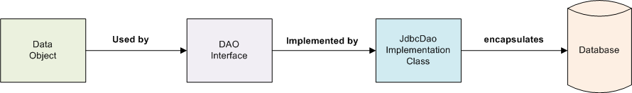
Parts of the DAO Pattern
The DAO Pattern breaks the responsibility of data access into 3 parts.
Data Object - a simple data object (POJO) often called a domain or business object. This data object will act as a data type that represents on row of data returned by the queries. It often matches the columns of the table being accessed.
DAO Interface - An interface that defines methods for the CRUD operations that the implementation class must provide. These methods will generally use either the DAO Domain Object or simple types (String, long, int, etc) as return types and arguments.
Implementation Class (JDBCDao) will implement the DAO Interface, take a DataSource as a constructor argument, and encapsulate the interactivity with the data source.

Slide 16
Setting Up the AddressBook database
In terminal
CD to the student-lecture/database folder that contains a script to create or recreate the addressbook database and data
yourname-java-blue/module-2/07_Database_Connectibity_DAO/lecture-student/database
Run the script
sh create.sh

